Slide 1


Technology Trends with Social Media
Eye2Data
Ajit Umale
Joe Koolippurackal
Karthik Srinivasaan
Mangesh Jadhav
Yongheng Zhan

Slide 2
1. The Problem 2. Problem Handling in Past 3. Data Processing, Exploration, Networks 4. Prediction Model & Results 5. Conclusion & Future Scope
Agenda

Slide 3
1.
The Problem

Slide 4
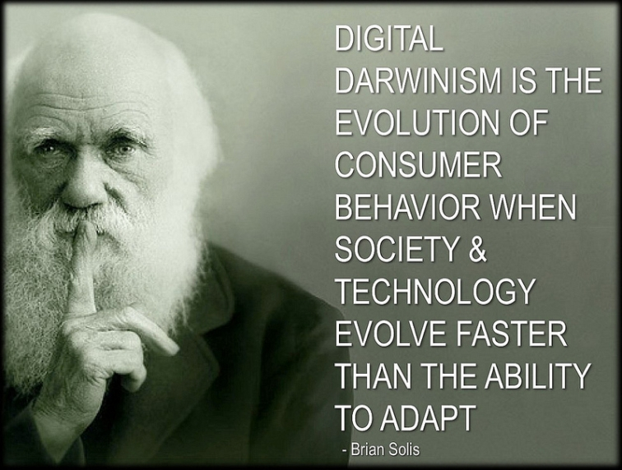

Slide 5
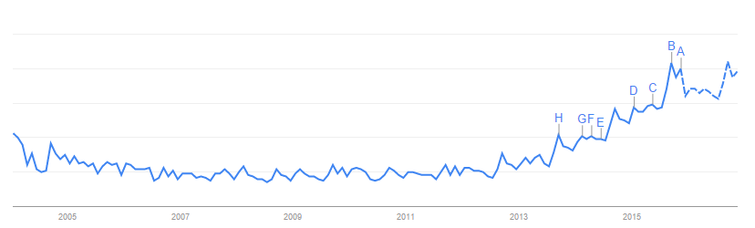

Changing Data Science Trends
Pig
Unix
Python
Ruby
MATLAB
SQL
R
C/C++
Perl
Scala
Java
SAS
100
Stack-Overflow
Data Science Google Trends (interest over time)
Twitter
20
Community of Active users
Working on Data Science Technology
Social Network of Common users Interested in Data Science Technology
Source: Google Trends

Slide 6
You are cruising along..
and then Technology changes..
You have to adapt.!!

Slide 7

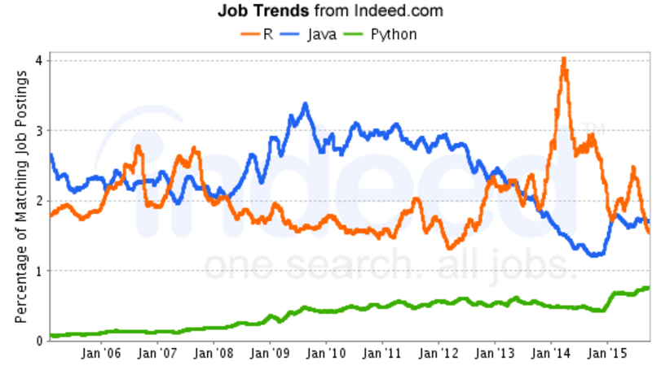


Universities
Update Curriculum
Data Science Jobs
Users
Skill Development
Source: Indeed.com
Organizations
Resource Allocation
Notes:
### Why the project

Slide 8
2.
Background

Slide 9




How it was handled in the past?
Gruzd, Wellman and Takhteyev
Formation of interlinked personal communities using Twitter.
Link
2005
2011
2013
April Edwards Kontostathis
Emerging Trend Detection using Text Mining.
Link
Barzilay, Treude,
and Zagalsky
Facilitating Crowd Sourced Software Engineering via Stack Overflow
Link

Slide 10
Why do we need Big Data?
Network thinking of data science discussions
Huge amount of Semi-structured data
Scope for analyzing multiple data sources
Scope for Spatial-Temporal analysis

Slide 11
3.
Data Processing

Slide 12





Data Collection & Processing
Stack-Overflow
(Data Explorer API to filter
Posts relevant to Data Science)
Twitter
(Python - Tweepy Package,
Bag of Keywords, 150 Blogs)
Structured Data Cleansing, Aggregation
Unstructured Data Cleansing, Aggregation
Filtering Data,
Creating Network Files (Document Term Matrix, Edge List),
Build Prediction Models
Visualize Networks & Communities
Notes:
The progress report 1 described the data collection and overall data profile. Here, we discuss briefly the steps we followed to prepare datasets for analysis. We collected data by filtering tweets and SO discussions related to 20 key topics. Instead of using the same keywords (that we came up with), we look at all the hashtags used in the discussions and hence avoid any selection bias. Regular expressions were used to merge all the variations of keyword use (considering big data, Big Data and Big-Data as the same term). Sanitization included manual inspection and removal of irrelevant discussions (tweets/posts which contain hashtags that are not related to data science in any way even though they contain r/Python/Java keywords). Further, out of 1334 unique hashtags in Twitter, the top 70 keywords in terms of their use frequency to ensure capture of popular discussions only. For SO, 309 out of 5285 hashtags were considered were considered based on maximum sparse index of 0.999 in the document term matrix (terms occurring in less than 0.1% occurrences were removed). In this way, the data processing is done to concentrate our analysis on trending data science topics.

Slide 13
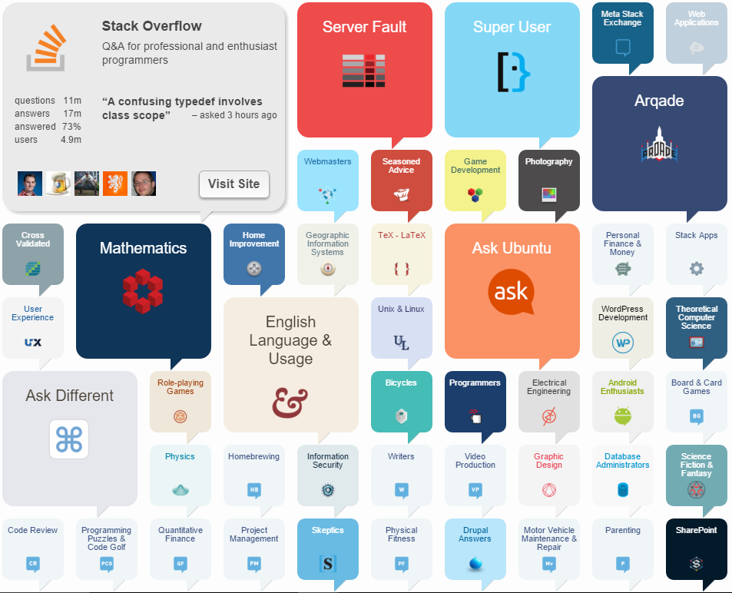
Stack Exchange (2014)
148 Communities
900M + Users
3.1 M Questions
4.5 M Answers
SE → SO → Data Science (R, Java, Python)

Slide 14
Stack-Overflow (65 weeks data)
90K
Post Count
Answer Count
Score
View Count
Favourite Count
Comment Count
Tags
Time & Location
Total Posts and Answers
41K users
Data Science users
5331 → 310
Total Tags → Tags after Sparse Term Removal

Slide 15
Twitter (1 month streaming, 1 year historical)
1.5 Million
Users
Hashtags
Tweets
Retweet Status
# of Followers
# of Favourites
User Mentions
Time & Location
Total Tweets
(~53% Tweets have Hashtags)
43K users
Users tweeting about data science
85K
Total Tweets by data science bloggers in 1 year
100+ users
Users with most popular data science blogs

Slide 16
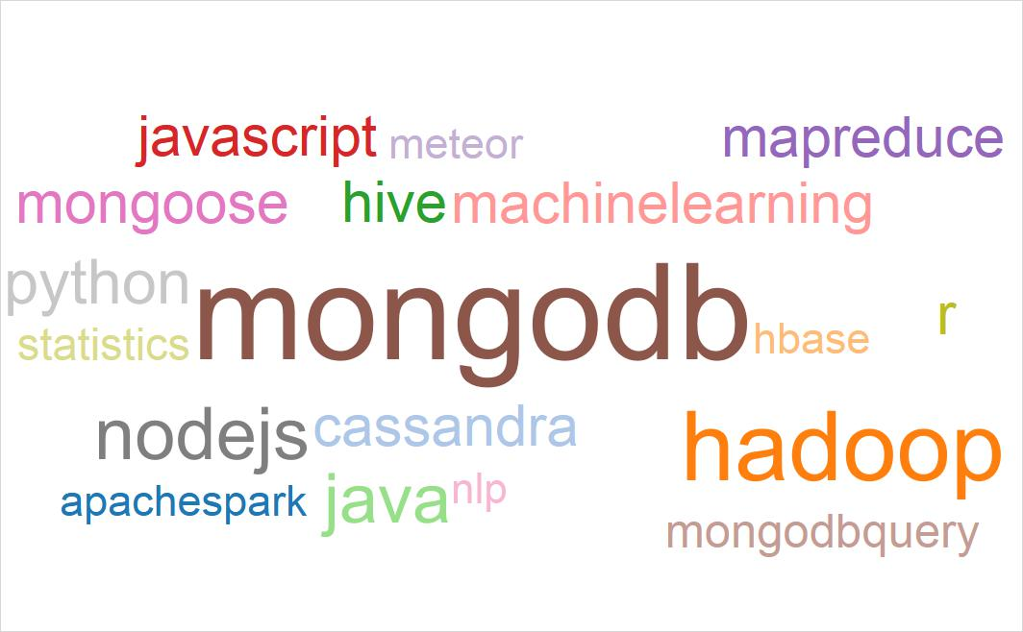
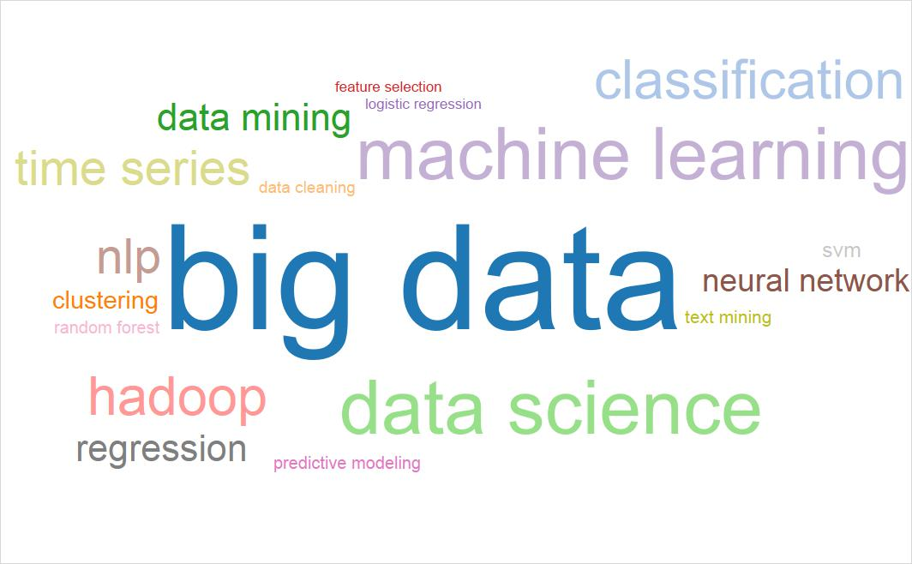
Comparison of Data Sources

Slide 17
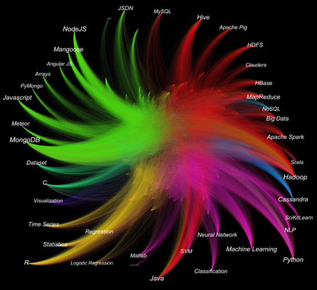
SO User Hashtag Bipartite Network
Introduction
Nodes: SO Users &Hashtags
Edges: Hashtags used by Users
Weight: Frequency of Hashtags
Visualization
7 distinct communities
User at center
Hashtags at periphery
Insights
Java used for Big-Data, Mining and Stats
R used for Statistics and Data Mining
Python used for Data-Mining

Slide 18
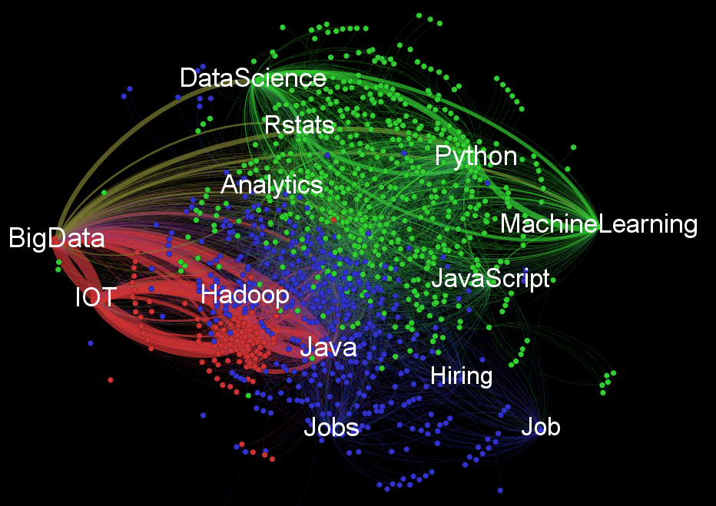
Twitter Hashtag Network
Introduction
Nodes: Twitter #tags
Edges: Co-occurrence of #tags
Weight: Freq of Co-occurrence
Visualization
3 distinct communities
Insights
Big-data #tag is commonly used with IOT, Hadoop, Java
Python, R , Machine Learning are part of Data science community
Tweets related to jobs co-occur with Big-data and Hadoop

Slide 19
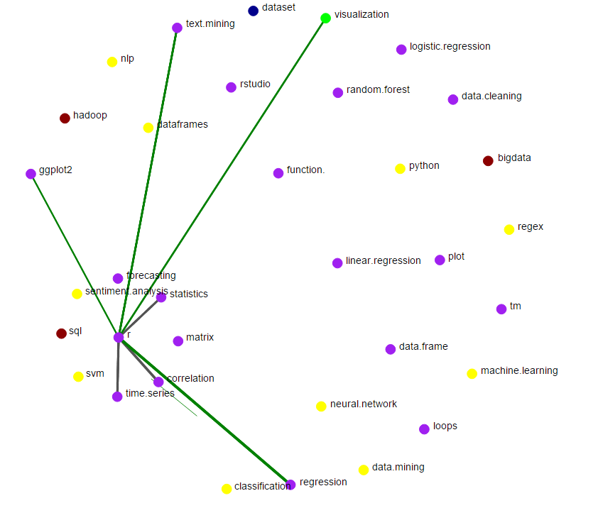
Place your screenshot here
Temporal Ego Networks
for R, Java, Python

Slide 20
4.
Prediction Model

Slide 21

What are we Predicting?
Number of Posts
+
Number of Answers
in communities
for a week**
User Participation
in R, Java, Python
discussions on Stack Overflow
**All predictor variables are having a lag of 1 week
Non-Network metrics are aggregated for every week
Network metrics are derived by creating graphs for each week’s data

Slide 22
Multi Step Prediction Process
Clustering Coeff.
& Sub Graph Centrality
Prediction with S4 + Twitter N/W metrics (S5)
Prediction with S1 + SO N/W metrics 2
(S3)
Prediction with SO attributes (S1)
Prediction with S1 + SO N/W metrics (1+2)
(S4)
Prediction with S1 + SO N/W metrics 1 (S2)
Closeness & Eigenvector Centrality
Conditional Inference Random Forest Stochastic Gradient Boosting Lasso Multivariate Adaptive Regression Splines
Conditional inference regression tree Random Forest

Slide 23
Prediction for R
Adding Stack Overflow N/W metrics improves prediction
Adding Twitter (external) information marginally improves prediction

Slide 24
Prediction for Python
Adding Stack Overflow N/W metrics improves prediction
Adding Twitter (external) information marginally improves prediction

Slide 25
Prediction for Java
Prediction is best when Closeness & Eigenvector centrality are considered
Twitter information for Java was not added

Slide 26
5.
Conclusion

Slide 27
Conclusion & Implications
Addition of Network Metrics helped in improving prediction
External data sources (Twitter) helped to marginally improve the prediction
R, Java, Python hold their own space in data science
Clustering Coefficient & Sub Graph Centrality helped to improve prediction for R, Python
Closeness Centrality & Eigenvector Centrality helped to improve prediction for Java

Slide 28
Looking back and forward
Limitations
Variable lagged effect of Twitter information on Stack Overflow discussions is currently not captured
Limited availability of historical tweets
Future Scope
Predict outcomes such as Job requirements, Salary, University coursework, Recruitment strategy, Appraisal process
Similar analysis of other social media (Quora, Reddit, LinkedIn)

Slide 29
Thanks!
“Data is the new science.
Big data holds the answers.”
– Pat Gelsinger

Slide 30


Questions?
I am Yongcheng Zhan!
Unfortunately, I am not here but..
I love to answer questions at the end of presentations.
Please send your questions at:
YongchengZhan@email.arizona.edu

Slide 31
Social Media and Technology
are not agents of change. They are just tools.
We the connected people
are the agents of change.
- Stuart Ellman

Slide 32
Summary of Prediction Results
 |  | RMSE (Root Mean Squared Error)
Language | Dataset | Lasso | Conditional Inference Random Forest | Stochastic Gradient Boosting | Multivariate Adaptive Regression Splines | Conditional inference regression tree | Random Forest
R | Set 1 | 28.63 | 24.62 | 22.47 | 23.86 | 29.87 | 12.16
 | Set 2 | 28.56 | 23.7 | 23.89 | 22.65 | 24.63 | 12.15
 | Set 3 | 28.65 | 23.19 | 21.87 | 22.99 | 29.87 | 11.78
 | Set 4 | 28.52 | 23.2 | 21.41 | 24.27 | 23.48 | 13.14
 | Set 5 | 27.69 | 21.56 | 22.01 | 21.6 | 23.84 | 11.65
Python | Set 1 | 34.36 | 29.15 | 24.9 | 27.01 | 26.67 | 16.72
 | Set 2 | 34.21 | 28.83 | 25.01 | 27.01 | 25.74 | 16.4
 | Set 3 | 34.27 | 28.71 | 24.69 | 30.13 | 26.67 | 16.51
 | Set 4 | 33.75 | 28.55 | 26.94 | 30.54 | 36.31 | 16.22
 | Set 5 | 33.02 | 25.35 | 24.2 | 23.6 | 27.62 | 14.99
Java | Set 1 | 31.82 | 29.36 | 29.33 | 31.21 | 29.45 | 17.58
 | Set 2 | 30.43 | 28.05 | 25.18 | 33.32 | 28.62 | 17.09
 | Set 3 | 31.34 | 28.18 | 28.08 | 32.66 | 28.81 | 17.06
 | Set 4 | 30.24 | 27.21 | 27.71 | 31.18 | 28.62 | 17.33

Slide 33
Feature importance (ranked for each model)
Variable | Python | R | Java
Average count of comment/post | 13 | 14 | 11
Average favorite count | 11 | 7 | 6
Average score | 14 | 11 | 8
Average view Count | 3 | 1 | 3
Closeness centrality (SO) | 9 | 8 | 2
Closeness centrality (Tw) | 4 | 2 | X
Eigen vector centrality (SO) | 15 | 13 | 5
Eigen vector centrality (Tw) | 16 | 5 | X
Lag | 1 | 6 | 4
Local clustering coeff (SO) | 12 | 12 | 7
Local clustering coeff (Tw) | 6 | 9 | X
No of posts commented | 8 | 10 | 9
Number of answers | 10 | 4 | 12
Subgraph centrality (SO) | 2 | 3 | 1
Subgraph centrality (Tw) | 5 | 15 | X
Total comments | 7 | 16 | 10

Slide 34
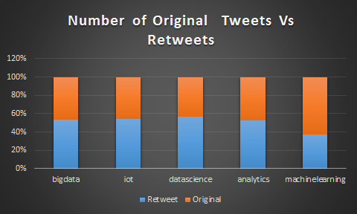
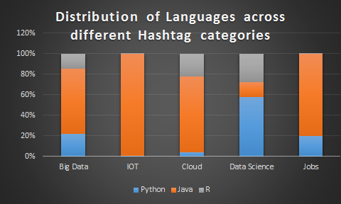
Exploratory Data Analysis
Information Diffusion via Retweets:
More retweets than original tweets
Relating trending topics with R, Java and Python:
Java most related with Big Data, IOT, Hadoop

Slide 35
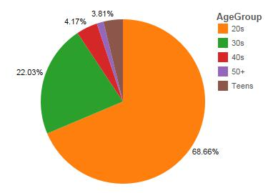
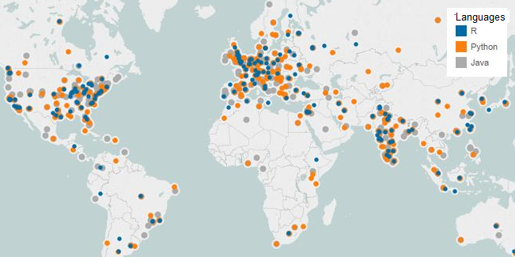
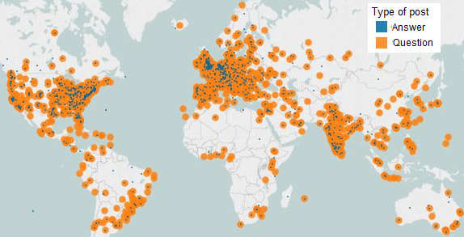
SO User Data Analysis
Age distribution skewed towards 20-30 age group with more than 68% young users
Active users from:
East USA (R)
Central Europe (R),
Indian sub continent

Slide 36
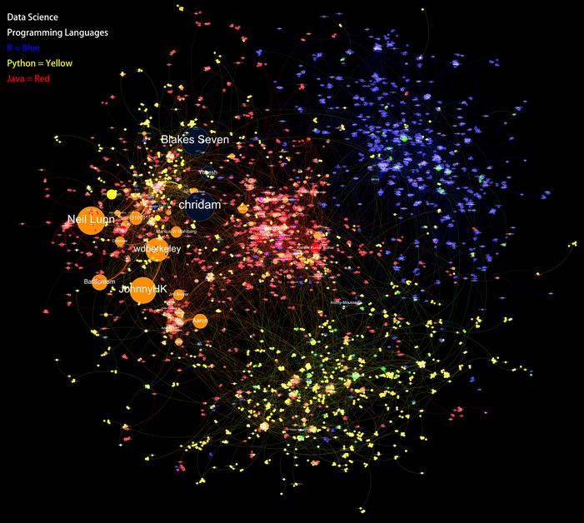
SO User Network
Introduction
Nodes: SO Users
Edges: Questions & Answers
Weight: Freq of common posts
Visualization
3 Distinct Communities
Insights
Languages Java and Python are closely related to each other
Users in Java community are less likely to interact with each other

